Slide 1
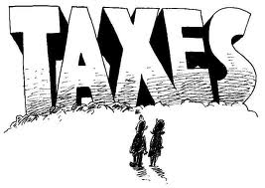
WHAT ACTIONS DID THE BRITISH TAKE THAT CAUSED UNHAPPINESS AMONG AMERICANS?
THE STAMP ACT
THE TOWNSHEND ACTS
THE BOSTON MASSACRE
4. THE BOSTON TEA PARTY

Slide 2
1. THE STAMP ACT
The British introduced a tax on legal documents such as wills etc.
Americans were furious to think that a ruler who lived 5,000 km away could tax them in this way.
Also furious because they had no representation in the British Parliament so why should they have the right to decide taxes for Americans.
Opposition to the taxes were summed up by the slogan ‘NO TAXATION WITHOUT REPRESENTATION’
As opposition grows, a Stamp Act Congress was set up to fight it. (from most colonies)
The British back down and end the Stamp Act.

Slide 3
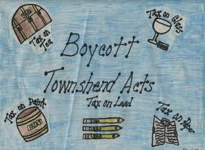
2. THE TOWNSHEND ACTS
In the early 1767, the British then foolishly introduced new taxes under the Townshend Acts.
This meant that they put taxes on everyday items such as glass and tea, paper, paint, lead which were not produced in North America and that the colonists were only allowed to buy from Great Britain.
The Americans refused to buy British products.
Instead, they smuggled in the goods they needed.
Boston was one of the main ports at the centre of this.

Slide 4
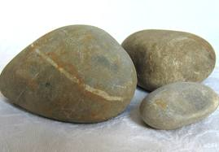
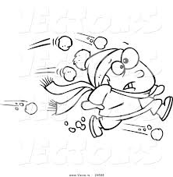
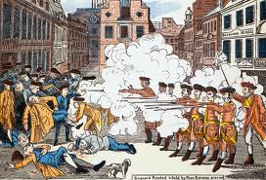
3. THE BOSTON MASSACRE
In March 1770 a mob of 50 men attacked a group of soldiers in Boston with stones and snowballs.
They were protesting against the Townshend Acts.
The soldiers opened fire and killed 5 men.
The Americans were outraged – they call the incident, the Boston Massacre.
They felt that the incident showed the cruelty of the British.

Slide 5
CHANGING OPINIONS
Many people began to feel it might be better if America controlled its own affairs (called patriots)
Because of the Boston Massacre and the refusal of the Americans to buy the taxed goods, the British took the duties off all the goods except tea.
The Americans continued to refuse to buy any tea imported from Britain

Slide 6
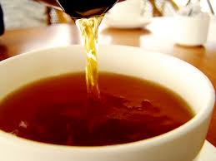
THE BOSTON TEA PARTY
In order to encourage Americans to buy British imported tea, the British allowed cut-price tea to be sold in America.
However, they continued to tax this tea.
Americans still not happy that the British were trying to tax them

Slide 7
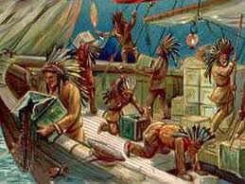
The Americans took matters into their own hands.
Some of them dressed up as Indians and boarded the ships carrying tea into Boston.
They threw all of the tea overboard into the harbour.
The British retaliated by introducing new laws (nicknamed the Intolerable Acts by the colonists)which closed down Boston port until Boston repaid the cost of all of the tea they had destroyed.
When they refused, General Gage was sent over to restore order. He closed the local assembly.

Slide 8
THE FIRST CONTINENTAL CONGRESS
THE BOSTON TEA PARTY
THE BOSTON MASSACRE
THE TOWNSHEND ACTS
THE STAMP ACT

