Slide 1
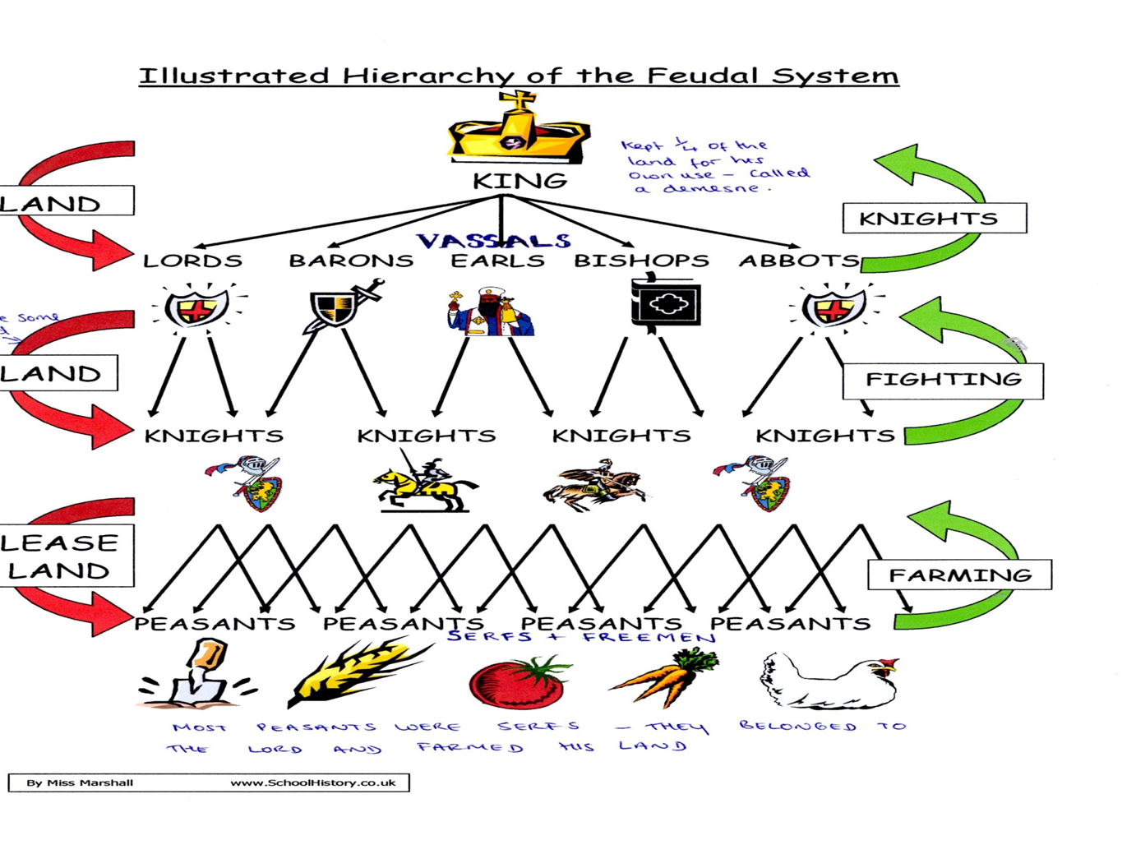

Slide 3
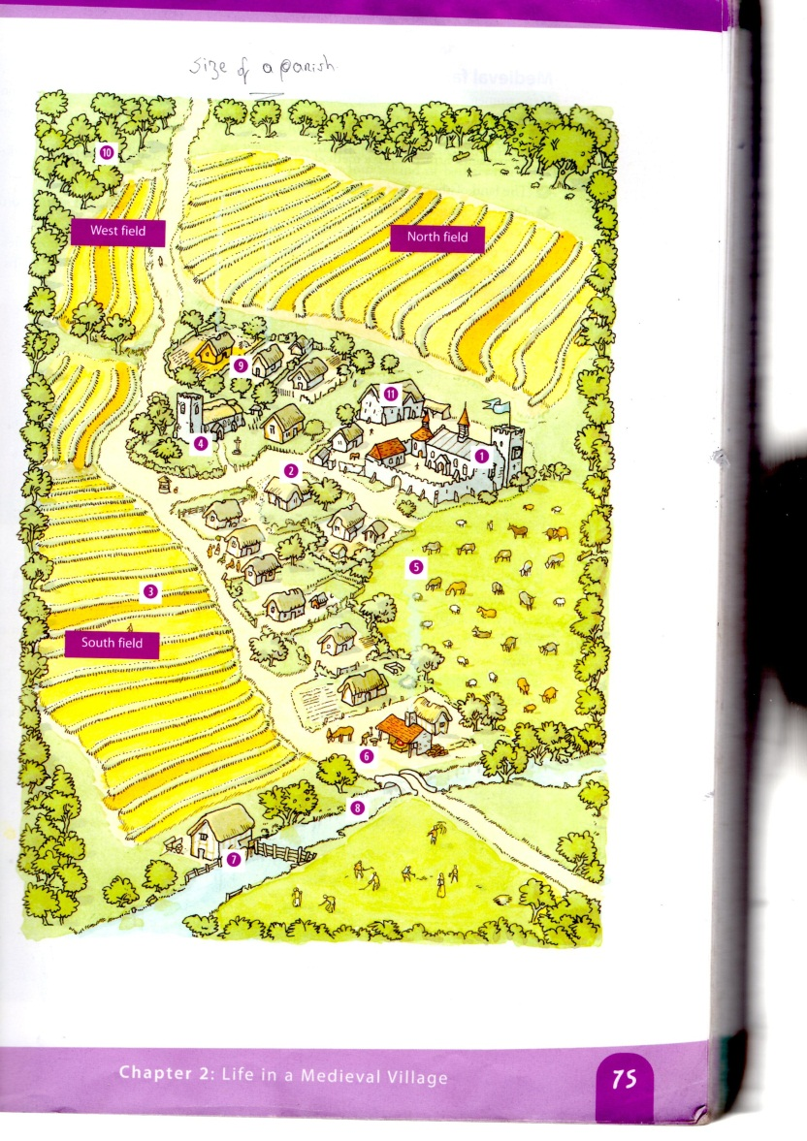
THE OPEN FIELD SYSTEM
ADVANTAGES
It ensured that the good and bad land was evenly divided.
DISADVANTAGES
The peasant’s land was divided between different fields which wasted their time as some of their fields could be quite a distance apart from each other.
The land in the village was divided into 3 huge open fields that could be many miles wide.
Each field was subdivided into long 1 acre strips separated by narrow grassy paths
The peasants were given strips of land in each field.
There was also one small patch of common land where peasants could graze their animals

Slide 4
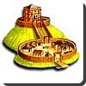
MOTTE AND BAILEY CASTLES
As soon as a lord got land from his king, he built a castle on it to defend himself and his people from enemies.
The first castles were called motte and bailey castles.
They were made of wood, were simple to make and were easy to defend.
The castles consisted of two basic parts.
(a) The motte – this was a mound of earth or a small hill built by the lord’s peasants. On top of this a wooden tower or fort was built. From this lookout post, the lord’s soldiers could see an enemy approaching.
(b) The bailey – this was a larger area below the motte surrounded by a fence. Most of the time, the lord and his soldiers lived in the bailey but if an enemy attacked, they went up into the motte.
A defensive ditch was usually dug around the motte and bailey.

Slide 5
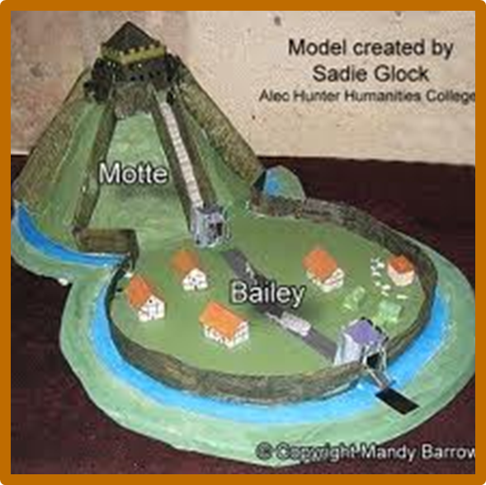
MOTTE & BAILEY CASTLES Easy to build – less than a week Easily modified later MAIN DEFENSIVE FEATURES Easy to defend Steep sides - means it is difficult to attack Surrounding ditches - another obstacle. Surrounding fence makes it a very strong fortress. MAJOR DEFENSIVE FRAILTIES: A Motte could collapse under the weight of a castle Wooden forts are susceptible to simple methods of attack eg burning. Over time they could rot due to bad weather.

