Slide 1
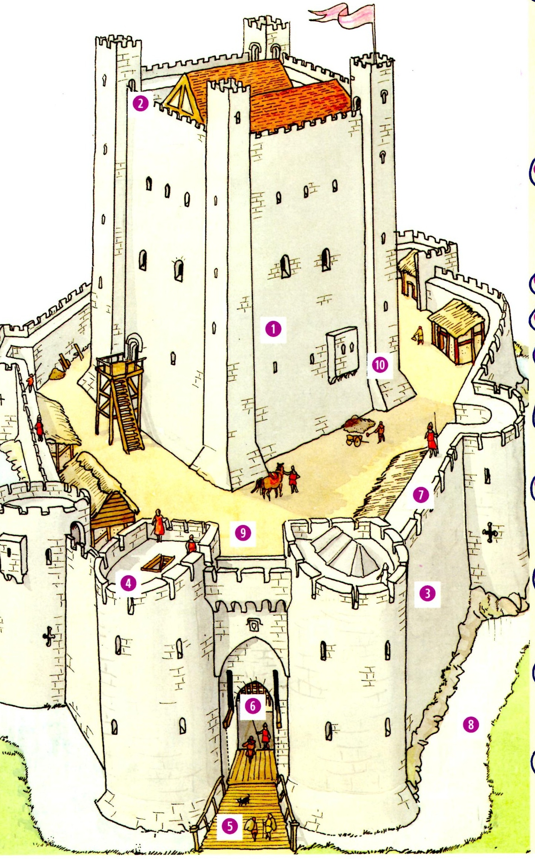

Slide 2
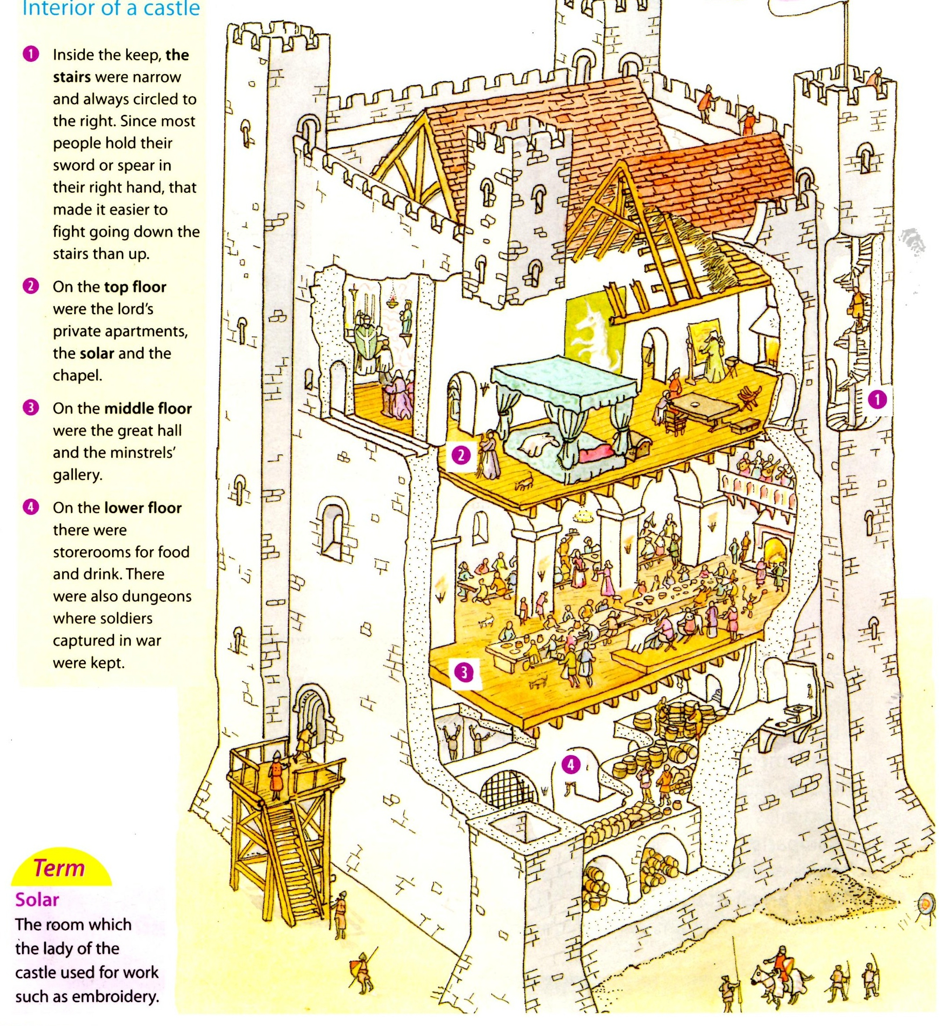

Slide 3
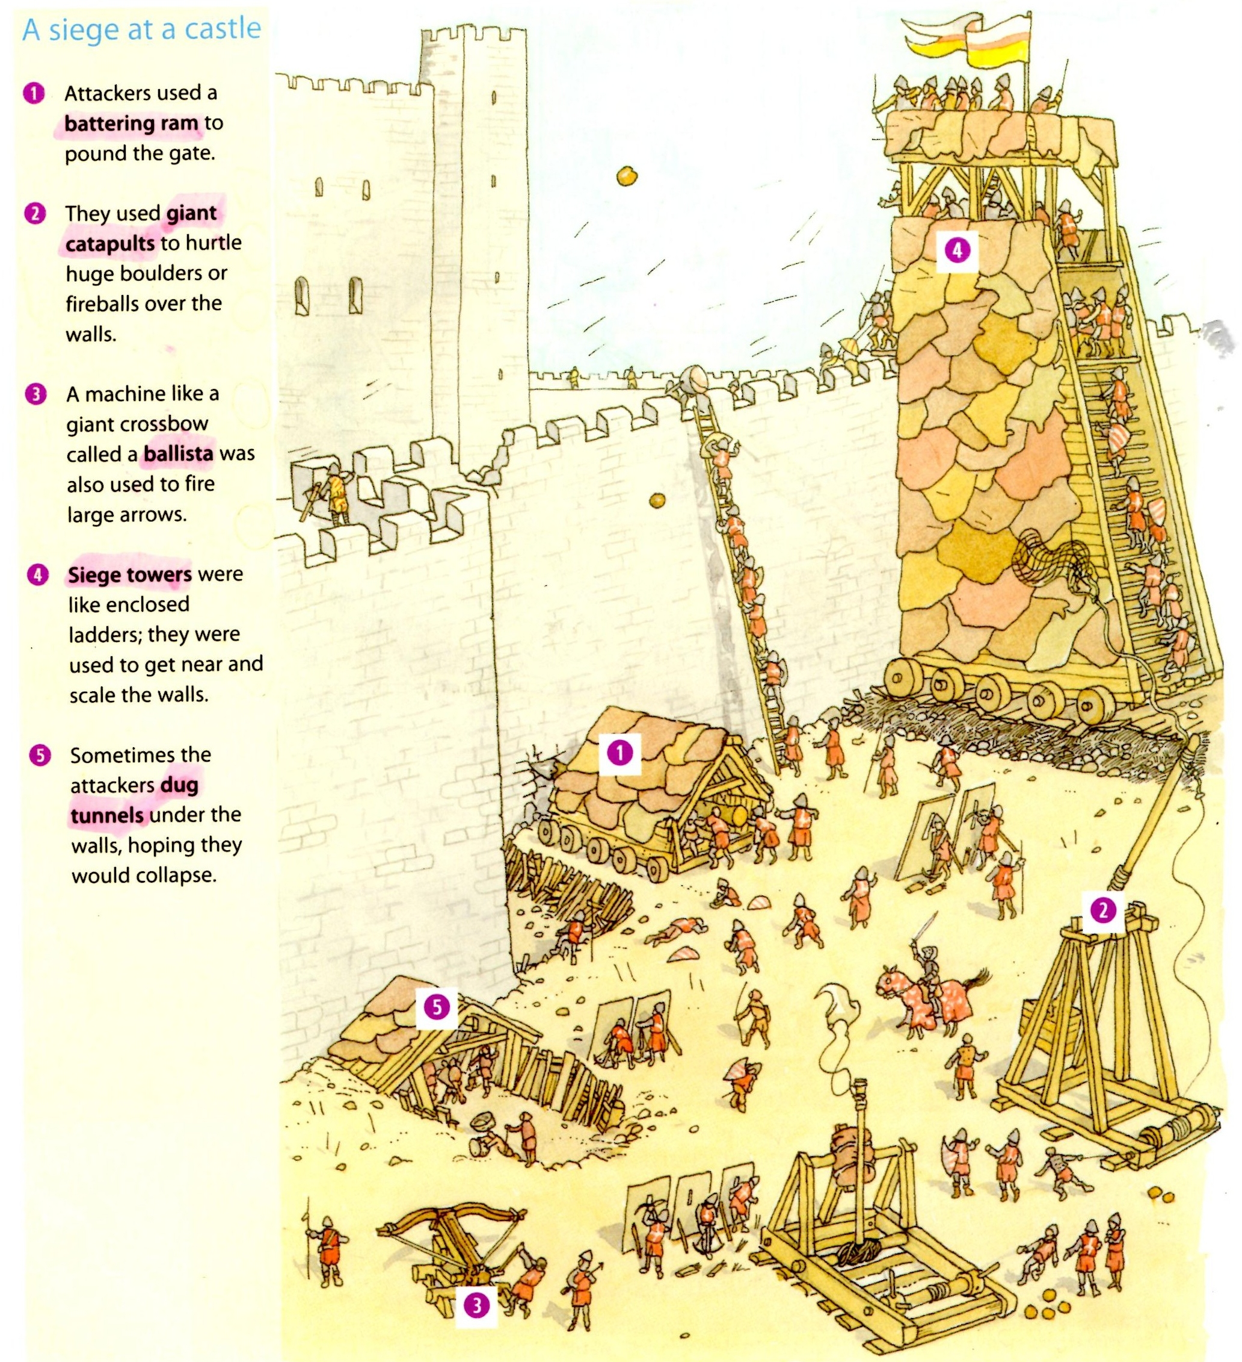

Slide 4
WEAPON | ADVANTAGES | DISADVANTAGES
BATTERING RAM | Very effective, especially if walls were not too thick. The weight of several men could be put behind it. | If walls thick – more difficult but still quite effective. Dangerous for those operating it because they were quite exposed.
FIRE | Useful against motte and bailey castles | Less effective on stone castles
SIEGE TOWER | Allows attackers to climb over the castle walls quite easily. | Mounds of earth piled up against the castle wall could stop the towers getting close. Also made of wood – could catch fire.
GIANT CATAPULT | Safe for attackers because they could be used from a safe distance away. Could cause serious structural damage or introduce disease into the castle. | Difficult to reload – not very mobile
MINING | Difficult to defend against | Dangerous for miners if it collapsed
GIANT CROSSBOW/BALLISTA | Safe for attackers because they could use it from a safe distance away Could cause a lot more damage than an ordinary crossbow. | Difficult to work and bulky

Slide 5
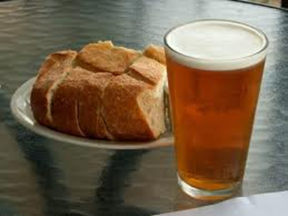
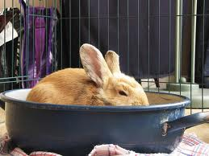
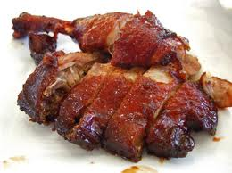
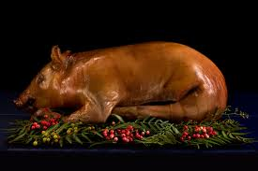
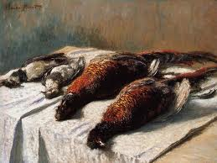
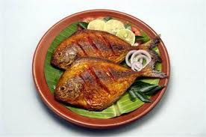
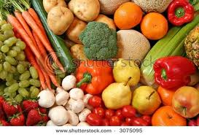
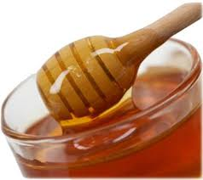

Slide 6
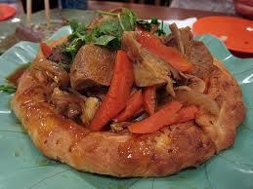
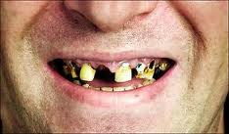
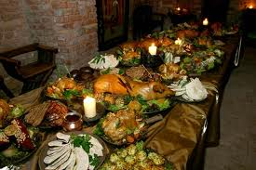
Food was served on wooden plates or on big slices of bread called trenchers.
Spoons and forks were not used. Instead, people used their fingers and knives. Things could get pretty messy. Scholars are still arguing whether or not they used napkins.
Toothpaste and toothbrushes did not exist in Medieval Europe. After a meal, nobles used watered spices on their lips, but all that did was briefly hide the smell of rotting teeth.
Banquets were common place and if the nobles had guests for dinner, they would hire entertainers - minstrels, magicians, jugglers - or perhaps one person would perform several feats.
http://www.youtube.com/watch?v=Xff4Z5xMMro – hh come dine with me

Slide 7
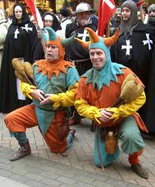
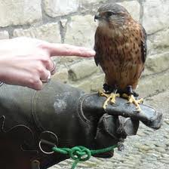
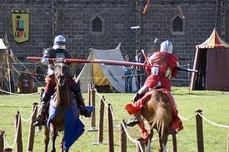
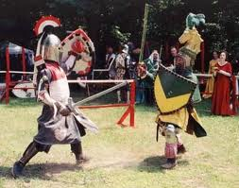
ENTERTAINMENT/PASTIMES
HAWKING – hawk trained to sit on a person’s shoulder and hunt songbirds and ducks
TOURNAMENTS – knights acted out mock battles – also enjoyed jousting
MINSTRELS, JESTERS, JUGGLERS, MAGICIANS
Hunting was also a very popular pastime and
provided food for the castle – deer, wild boar, foxes

