Slide 1
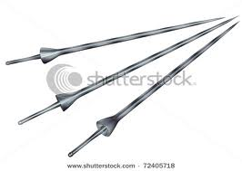
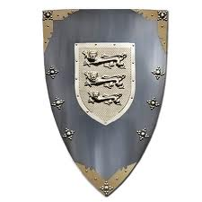
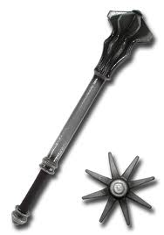
A KNIGHT DRESSED FOR BATTLE
Helmet
Breast plate
Babraces
Gauntlets
Mail skirt
Cuisses
Greaves
Lance
Sword
Shield
Mace
http://www.ictgames.com/knightinarmour.html - dress the knight

Slide 2
The 3 stages to becoming a knight
PAGE
At the age of seven, a nobleman’s son was sent to another castle to be trained as a page.
He learned how to fight, how to use weapons and how to ride a horse.
He also learned to sing, dance and have good manners.
He served the lady of the castle at the table and helped the lord to dress.
SQUIRE
At the age of 14 he became a squire and was assigned to a knight.
The squire assisted the knight by helping him to dress. He would also serve all his meals, care for his horse and clean his armour and weapons.
The squire continued to learn how to fight.
If there was a war, he went with his lord and helped with his armour and his horse.
Knight
When he was about 21 a squire could become a knight if he had proved himself worthy – i.e., skilful and brave.
He was made a knight during a special ceremony called dubbing.
The night before the ceremony, the squire spent time in the church, praying that he would be a good knight and that we would never fail in his duty.
The next day the squire would dress in a white tunic, a red robe, and a black jacket.
He would then keel in from of the lord and swear to uphold the code of chivalry.
The lord tapped the knight on the shoulders and head with a sword and proclaimed him a knight – ‘Arise, Sir Knight’

Slide 3
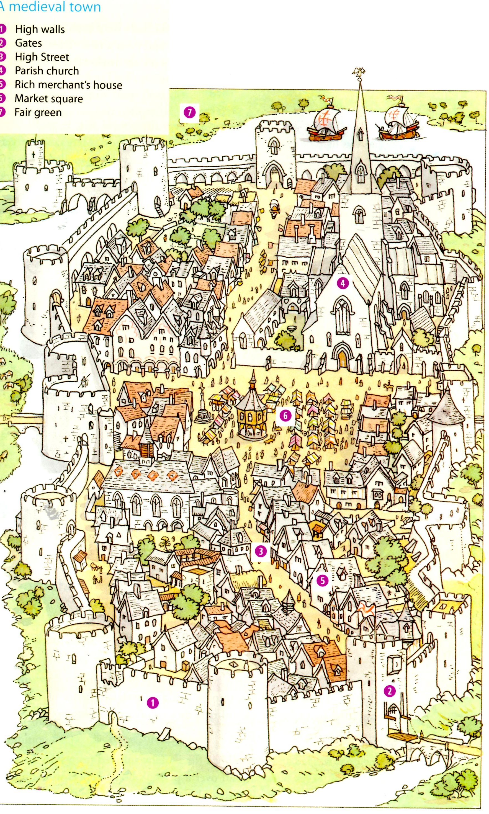

Slide 4
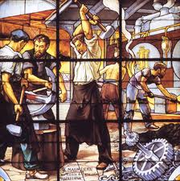
GUILDS
Guilds were organisations that were set up to regulate trade in various crafts. They:
(a) set examinations to make sure craftspeople were good at their trade.
(b) set standards of work
(c) set decent wages
(d) looked after old or sick members
(e) paid for members’ funerals
(f) women could join if their husbands had died

Slide 5
CHURCHES & CATHEDRALS
ROMANESQUE
GOTHIC
Round arches
Decorations over the doors
Thick round columns inside the church for support
Thick walls – so small windows – little light
Dark interiors
Spires & towers
Pointed arches
Slim interior columns
Big windows – stained glass
Flying buttresses outside to support the roof
Stone statues over doors and windows

Slide 6
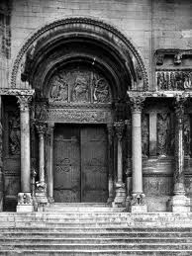
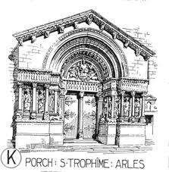
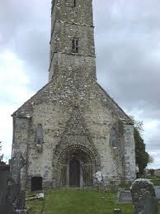
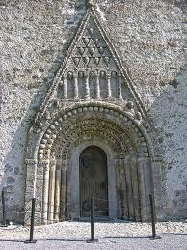
CLONFERT CATHEDRAL,
CO GALWAY
(LAST TWO PICS)
ROMANESQUE STYLE
Round arches, decorations over the door, thick walls, dark interiors

Slide 7
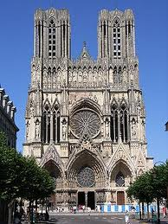
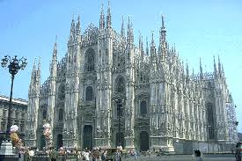
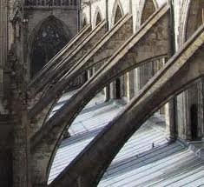
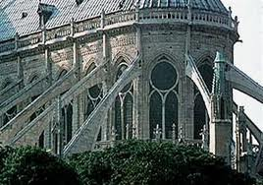
GOTHIC CHURCHES – SPIRES, POINTED ARCHES, FLYING BUTTRESSES

Slide 8
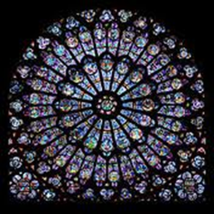
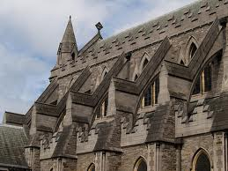
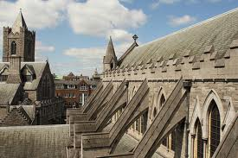
CHRISTCHURCH CATHEDRAL DUBLIN (NOT ROSE WINDOW)

Slide 10
We monks are very self sufficient – we grow our own food, make our own medicines and make our own furniture.
Some of the monks carry out other jobs:
(a) almoner – looked after visitors/travellers at the monastery.
(b) the infirmarian – looks after the sick and the making of medicines from herbs etc.
(c) the librarian – looks after the library
(d) the illuminator – creates the artwork in the manuscripts which are made in the scriptorium.
Some monks are called friars and they travel from place to place working with the poor. They are called Franciscans after their founder, St Francis of Assisi.

Slide 11
HOW THE NORMANS CHANGED IRELAND
They built over 2000 castles – first motte and bailey castles, then stone castles – eg Trim Castle.
They brought the feudal system of farming.
They set up towns to make it easier to trade.
They were the first people to use English here.
They held the first parliament here.
They built monasteries and cathedrals (mostly Gothic)
They set up the parish system – each manor was a parish with a priest and a church
They brought new surnames which are still common today, eg Fitzgerald, Fitzsimons, Burke, Power,

